Slide 1
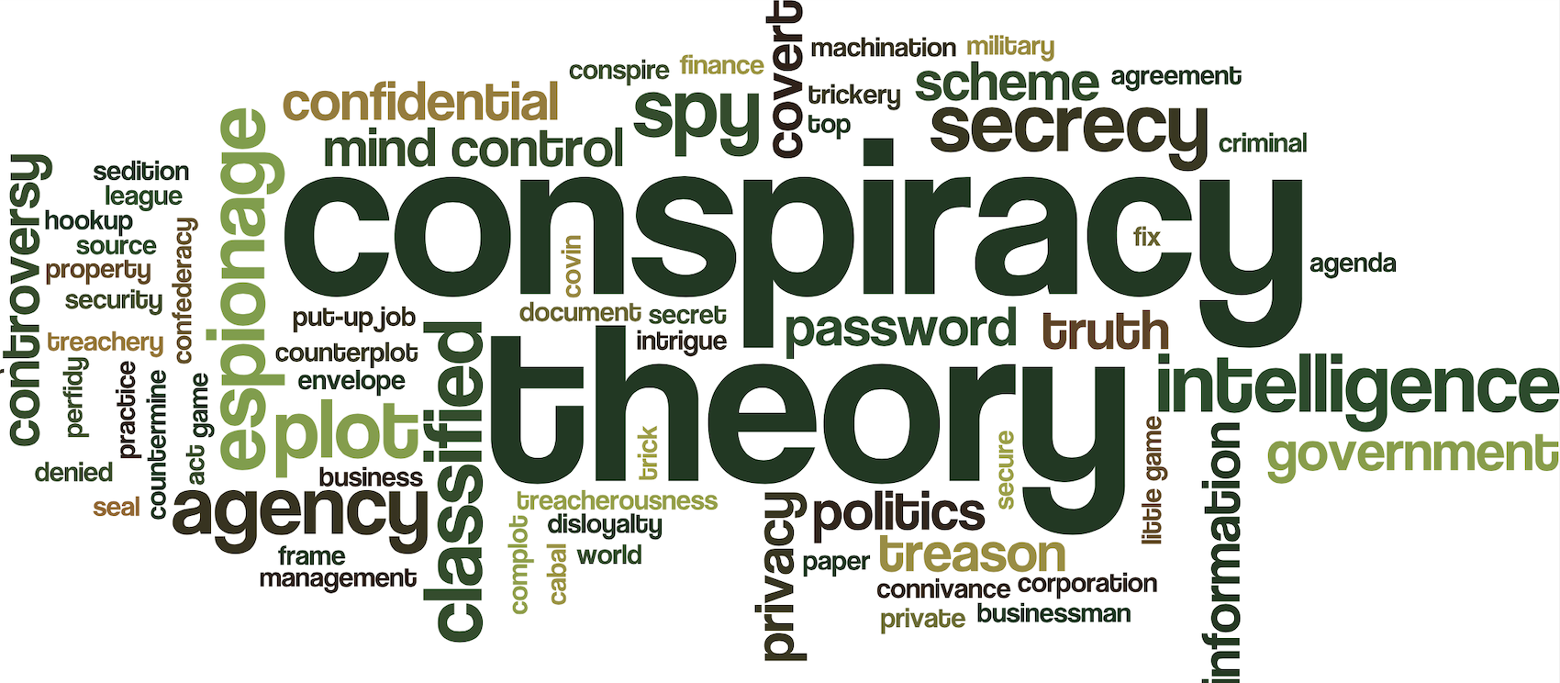

Slide 2

Layout
Definitions
Two Trivial Examples
Why is this Important?
Biblical Relevance
Substantial Example
Conclusion

Slide 3

Conspiracy Theory Definition
“A theory that explains an event or set of circumstances as the result of a secret plot by usually powerful conspirators”
Merriam Webster Dictionary

Slide 4
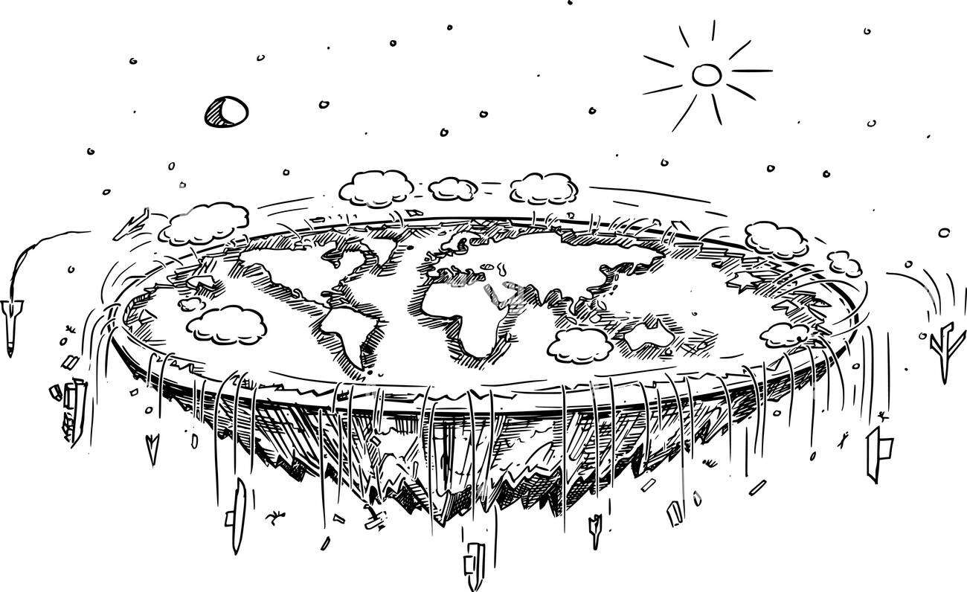

Slide 5


Slide 6

Importance
Understanding the world.
Understanding the enemy.
Staying alert.
Maintaining Perspective.
Test all things (1 Thessalonians 5:21)

Slide 7

Ephesians 6: 11-12 (NKJV)
¹¹ Put on the whole armor of God, that you may be able to stand against the wiles of the devil. ¹² For we do not wrestle against flesh and blood, but against principalities, against powers, against the rulers of ^{[c]}the darkness of this age, against spiritual hosts of wickedness in the heavenly places.

Slide 8

Strong’s Concordance
wiles (of the devil): cunning arts, deceit, craft, trickery
principalities: magistrate, power, principality, principle, rule
powers: one who possesses authority
physical or mental
the power of rule or government
rulers: the devil and his demons

Slide 9

Some Large Organization
“The largest and most influential organization in the world”
- Oakridge MUN 2023
“As the world’s only truly universal global organization, this organization has become the foremost forum to address issues that transcend national boundaries”
- Organization’s website

Slide 10

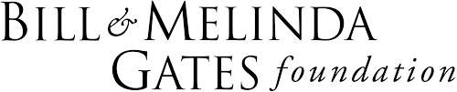






Slide 11

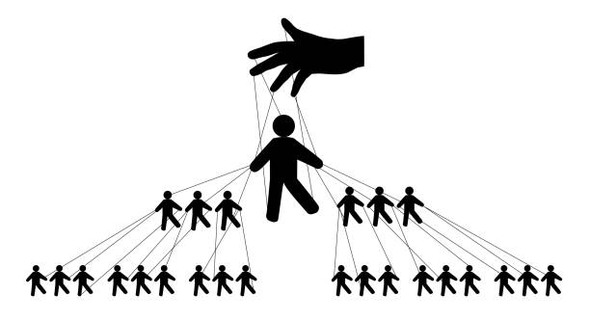
The conspiracy
This organization is heavily connected with Satanic Influence/Worship.

Slide 12
Lucis Trust
Headquarters are in the organizations building!
They have Consultative Status with the Economic and Social Council of the organization.
Play an active role in the organization
Give their support through meditation, educational materials, presentations, discussions, videos, seminars, suggestions for action, etc.
Participates in organization events, contributes to policy discussions, and engages with member states.
Source: Lucis Trust website and organization website

Slide 13
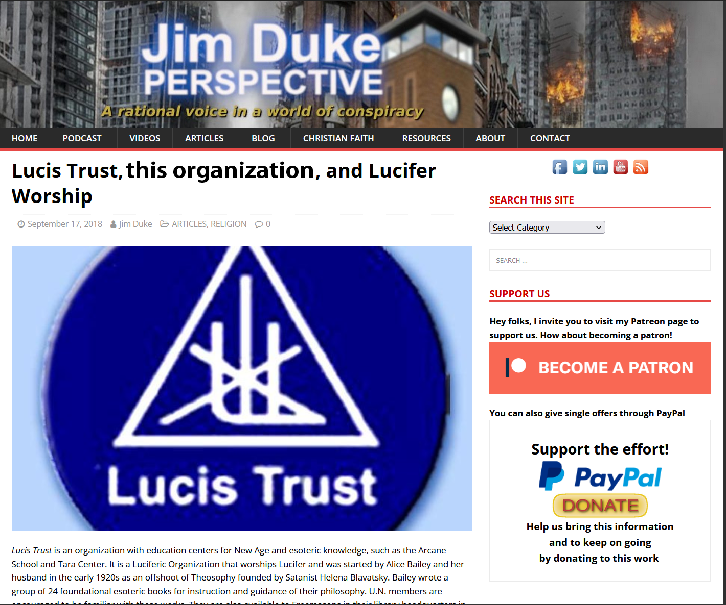

Slide 14
Lucis Trust (according to themselves)
“The activities of the Lucis Trust promote the education of the human mind towards recognition and practice of the spiritual principles and values upon which a stable and interdependent world society may be based.”
“In the theosophical perspective, the descent of these solar Angels was not a fall into sin or disgrace but rather an act of great sacrifice, as is suggested in the name “Lucifer” which means light-bearer.”
“The Solar Gods are the Fallen Angels.” … “They are the Serpents of Wisdom.” … “Their nature is Knowledge and Love.”
“... for Satan himself transforms himself into an angel of light.” - 2 Corinthians 11:13

Slide 15
Lucis Trust (according to themselves)
“This is the work of the New Group of World Servers and the intelligent men of goodwill. Their name is Legion.”
Mark 5:9
⁹ Then Jesus asked him, “What is your name?”
“My name is Legion,” he replied, “for we are many.

Slide 16
The United Nations

Slide 17
Conclusion
How does this affect us?
It’s how Satan works the world we live in.
¹¹ Put on the whole armor of God, that you may be able to stand against the wiles of the devil. ¹² For we do not wrestle against flesh and blood, but against principalities, against powers, against the rulers of ^{[c]}the darkness of this age, against spiritual hosts of wickedness in the heavenly places. - Ephesians 6: 11-12 (NKJV)

